Slide 1

Online Book store.
Mariam Essam Abo Mandour.
Nada Reda Mohamed elsebaei.

Slide 2
About the project:-
Online Book store for readers to find more books easily in different ctegories, buy,download and read them in easy way .
1-Reader have account to login and sign up
2-Reader can show many categories and many books inside them.
3-Reader can buy /download books and make review for the books he read .
4-Reader can contact library to recommend books etc...
5-Reader can read or write articles.
6-Reader can search for books.

Slide 3
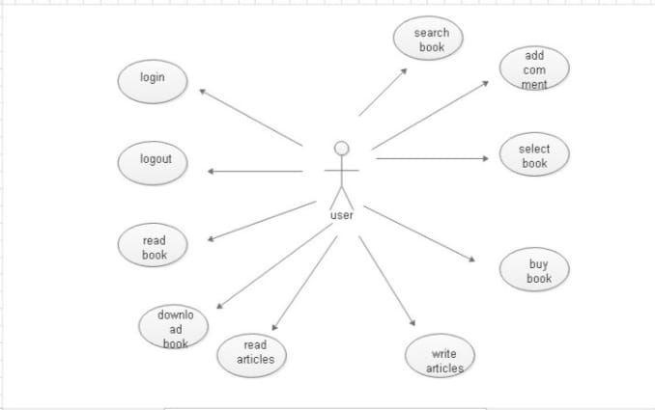

Slide 4
About the project:-
Online Book store for Admin to show their books for selling.
1-Admin can add librarian in each category to organize categories(Add,Delete).
2-Admin can add or delete user/librarian.
3- Admin can add or delete categories
Online Book store for librarian.
1-librarian can add or delete books.
2-librarian can remove review.

Slide 5
